Slide 1
Maths Mastery Year 5 and 6

Slide 2
Why the change?
Curriculum 2014 states that children must stay within their band – deeper rather than further
As an outstanding school we are always looking to improve our practice – mastery is something we are taking on in all subjects, not just maths
Research shows that mixed ability groups learn best
All children can achieve – raises confidence and standards in Maths

Slide 3
Maths Mastery in Year 5 and 6
The maths taught to Year 5 & 6 is a gradual introduction to the mastery approach – focus on problem solving and questioning
The school is bridging the gap between sets and mixed ability teaching
Enrichment team offer GT support and challenge to pupils which can change on a weekly basis
Intervention offered to those children struggling to grasp concept within the same day

Slide 4
What do the children think it is?
I think Maths Mastery is a way to challenge you to think differently and deeply. I think it is good because I like challenging myself and it helps me see my mistakes.
Kristina 6B
Maths Mastery is when you show your understanding in various ways and deepen your understanding in a particular area. This will help everyone.
Trisha 6D
Maths Mastery is an advanced form of learning in maths because it is more challenging than the previous task. Nils 6C
Maths Mastery is when you’ve perfected your learning and shown your understanding. I feel this is good because it helps me truly know what I am doing and why I do it.
Danyaal 6B

Slide 5
What does it look like, in Year 5 and 6?
The essential idea behind mastery is that all children need a deep understanding of the mathematics they are learning.
NCETM, 2015

Slide 6
What does it mean to master something?
I know how to do it
It becomes automatic and I don’t need to think about it
I’m really good at doing it
I can show someone else how to do it.

Slide 7
What does it look like, in Year 5 and 6?
All children have the opportunity to :
Use and develop prior knowledge
Be exposed to different learning styles
Consolidate their learning
Be challenged
Deepen their understanding

Slide 8
High attaining pupils
Provides sufficient time to go deeper
Provides the simplicity to develop clarity of the mathematics and make connections
Ensures that there are no gaps in learning that would hinder future progress

Slide 9
Struggling learners
Provides small steps to support learning and make connections
Provides sufficient time to embed learning
Provides sufficient scaffolding to enable progress

Slide 10
Problem Solving
Reasoning
Apply mathematics
Conjecture relationships & generalisations
Fluency
Rapid & accurate recall
Break down problems and persevere
Mathematical Language
Conceptual understanding

Slide 11
How are we doing this…?
Reasoning…
What do you notice?
True or False?
Odd one out
Spot the mistake
Give me an example …
Prove it

Slide 12
How are we doing this…?
Reasoning…

Slide 13
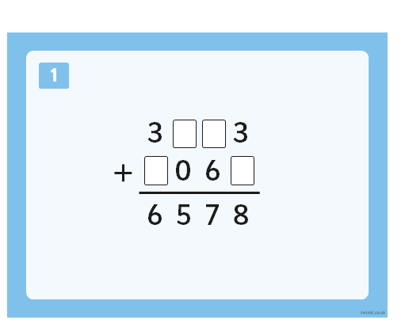
How are we doing this…?
Fluency…

Slide 14
How are we doing this…?
Fluency and reasoning…

Slide 15
How are we doing this…?
Problem solving…

Slide 16
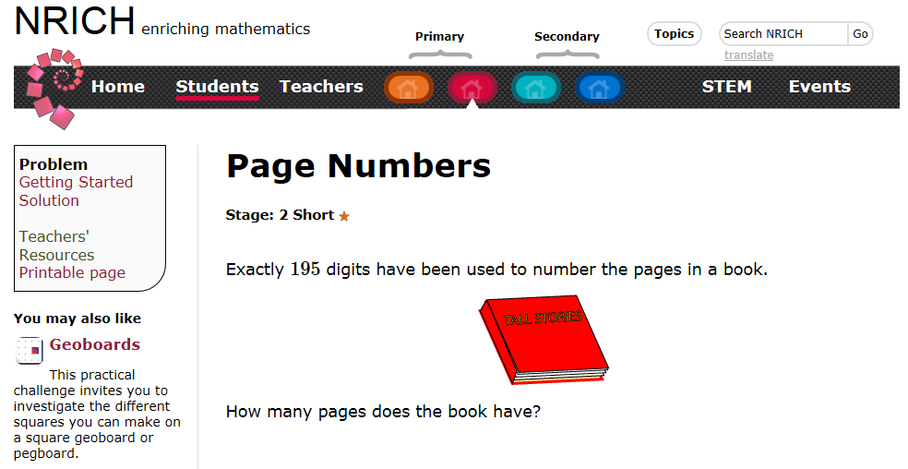
How are we doing this…?

Slide 17
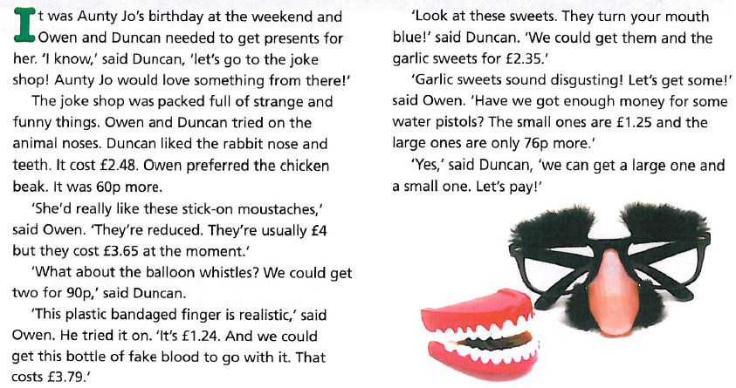
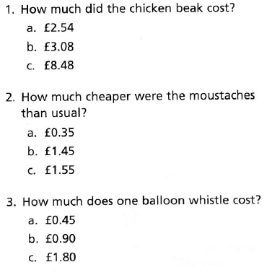
How are we doing this…?

Slide 18
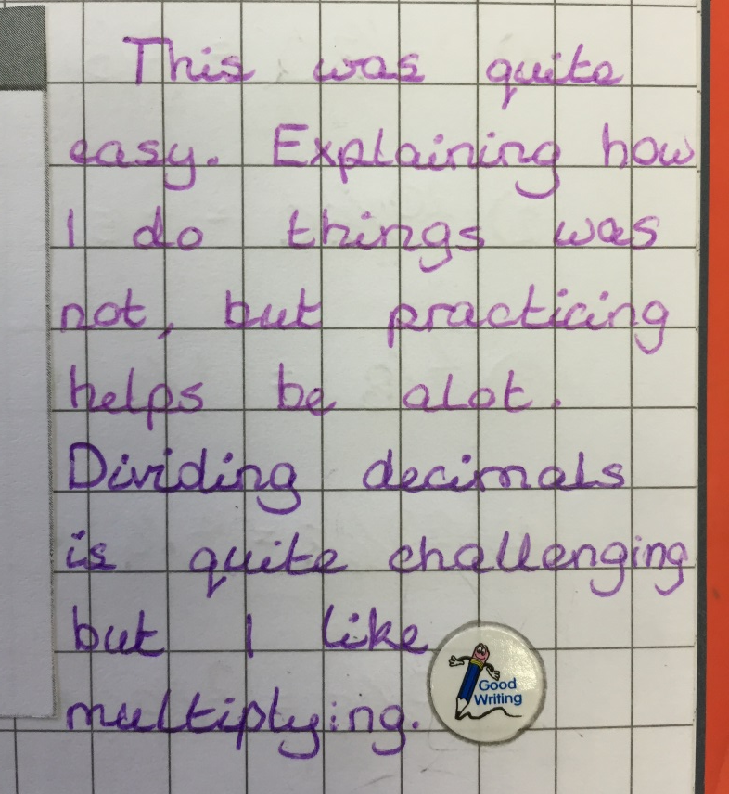
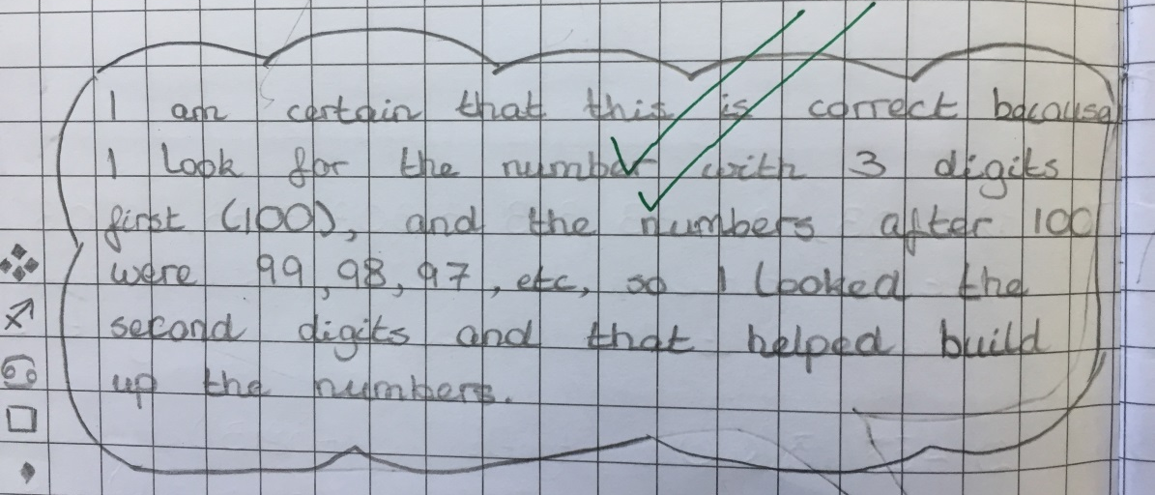
How are we doing this…?

Slide 19
